Slide 1

Review 1 Embedded Machine Learning for Early Prediction of Heart Attack Symptoms Project Category: PRODUCT
Guide Name Student Name & Registration Number
Dr. R Jeya
VIVEK M G – RA2211003010002
RAGHURAM SRIKANTH – RA2211003010218

Slide 2
Abstract
Heart attacks are the most common cause of early deaths and accidents, and early signs are often missed.
This project embedded machine learning with both electric and fuel-powered cars to make it possible to predict a heart attack while the driver is on the road driving the vehicle.
The system continuously monitors physiological signals and analyzes them locally using a simple machine learning model. a
Additionally, it searches for symptoms of potential cardiac issues. It ensures the safety of the driver's life by issuing immediate warnings, thereby reducing the risk of accidents caused by cardiac conditions.
This approach enhances the safety of vehicles and the quality of healthcare by enhancing vehicles’ intelligence and ability to respond to health crises.

Slide 3
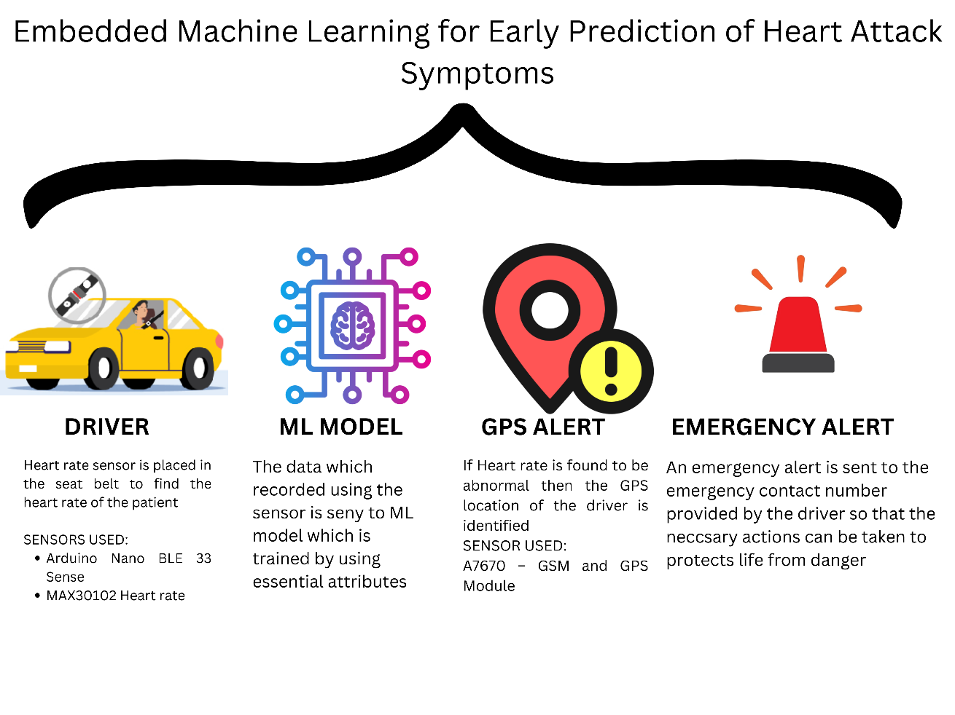
Introduction
Heart attacks are the most common cause of early deaths and accidents, and early signs are often missed.
This project embedded machine learning with both electric and fuel-powered cars to make it possible to predict a heart attack while the driver is on the road driving the vehicle.
The system continuously monitors physiological signals and analyzes them locally using a simple machine learning model.
Additionally, it searches for symptoms of potential cardiac issues. It ensures the safety of the driver's life by issuing immediate warnings, thereby reducing the risk of accidents caused by cardiac conditions.
This approach enhances the safety of vehicles and the quality of healthcare by enhancing vehicles’ intelligence and ability to respond to health crises.

Slide 4
Project Objective
To develop an intelligent, real-time health monitoring system embedded within vehicles that leverages machine learning to detect early symptoms of heart attacks in drivers—enhancing road safety, enabling timely medical intervention, and ultimately contributing to the reduction of sudden cardiac-related accidents, in alignment with global health and safety goals.

Slide 5
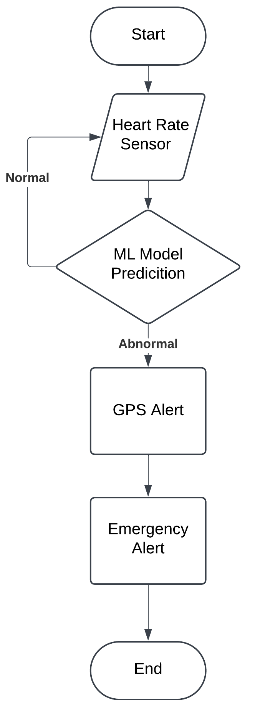
System Architecture based on current user stories

Slide 6

Product Roadmap/ Release Plan

Slide 7
Hardware Requirements
To enable the real-time monitoring and prediction of heart attack symptoms in vehicles, our system relies on a robust and efficient hardware setup. This hardware architecture is designed to ensure seamless integration with both electric and fuel-powered vehicles while maintaining high accuracy, low latency, and energy efficiency.
The following components form the backbone of our embedded machine learning system:
MAX30102 : Measures heart rate (BPM) and blood oxygen levels (SpO2) —critical indicators of cardiovascular distress.
GSR (Galvanic Skin Response) Sensor : Detects stress and fatigue levels , providing additional context for anomaly detection.
TMP117 : A high-precision temperature sensor that monitors body temperature fluctuations associated with heart distress.

Slide 8
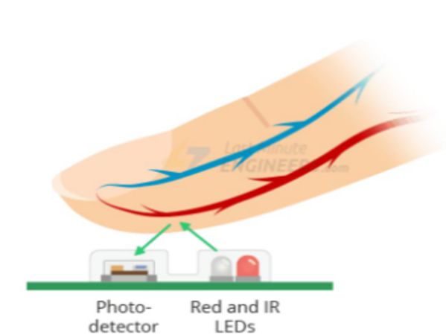
MAX30102 Pulse Oximeter and Heart-Rate Sensor
The MAX30102 sensor is crucial for non-invasive monitoring of vital health metrics, particularly blood oxygen levels (SpO₂) and heart rate. These measurements are essential for assessing cardiovascular health and detecting potential issues early. By accurately tracking these parameters, the sensor provides valuable insights into a person’s heart health, making it ideal for wearable health devices and medical monitoring systems.
Components: It combines red and infrared LEDs, photodetectors, optical parts, and low-noise electronics that block out ambient light, helping it take really accurate readings.
Power Requirements: Operates with a 1.8V supply for the sensor and a separate 3.3V supply for the LEDs, optimizing power consumption.
Communication Interface: It talks to the microcontroller using an I²C interface, which keeps data transfer simple and quick.
Applications: You’ll commonly find it in fitness trackers, smartwatches, and other wearable health gadgets for real-time health monitoring.

Slide 9
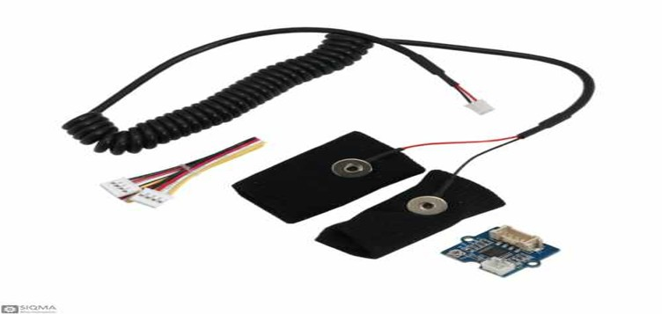
Galvanic Skin Response (GSR) Sensor
The GSR sensor measures the electrical conductance of the skin, which varies with sweat gland activity—a response linked to stress and emotional arousal, factors influencing cardiac events.
Functionality: Detects changes in skin conductance to assess stress levels, providing insights into autonomic nervous system activity related to heart health.
Integration: Interfaces with the MCU via analog input pins, offering real-time data for continuous monitoring.

Slide 10
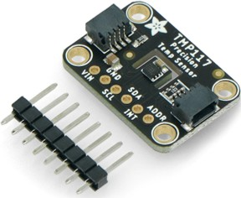
TMP117 Temperature Sensor
The TMP117 is a high-precision digital temperature sensor critical for monitoring body temperature variations, which can signal physiological stress or infection affecting cardiac function.
Accuracy: Delivers precise temperature readings, enhancing the reliability of health assessments. It provides highly accurate temperature measurements, which helps make health assessments more reliable.
Communication: It uses an I²C interface, making it easy to connect and work smoothly with Arduino Nano 33 BLE Sense Rev2
Applications: It’s a great fit for medical equipment, wearable health trackers, and environmental monitoring systems.

Slide 11
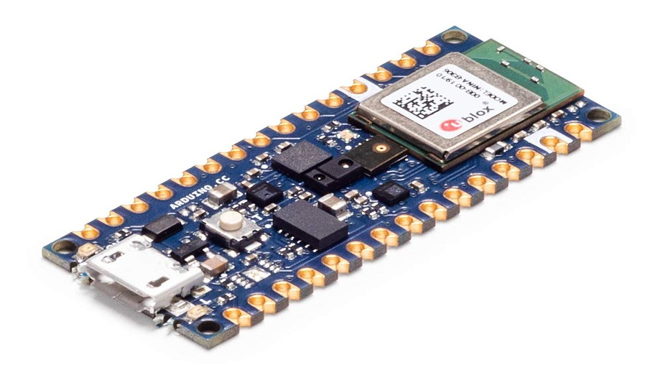
Why Did We Choose the Arduino Nano 33 BLE?
Arduino Nano 33 BLE Sense Rev2 serves as the central microcontroller unit in our system, orchestrating data acquisition, processing, and communication tasks.
Processor: It runs on an nRF52840 microcontroller with a 32-bit ARM Cortex-M4 CPU at 64 MHz, offering a good mix of speed and low power usage.
Memory: It comes with 1 MB of flash storage and 256 KB of SRAM, which is enough to handle machine learning models and store sensor data comfortably.
Wireless Communication: It supports Bluetooth® 5.0 Low Energy (BLE), making it easy to send data to other devices for real-time monitoring and analysis.
Integrated Sensors: It’s packed with a 9-axis motion sensor (IMU), environmental sensors (for temperature, humidity, and pressure), and even a digital microphone, helping it gather extra information about the surroundings.

Slide 12

ML Implementation Using TensorFlow Lite
Step 1: Data Collection
Collect real-time data from MAX30102 (Heart Rate/SpO2), GSR (Stress), and TMP117 (Temperature) sensors.
Use synthetic_heart_attack_data_balanced.csv for training.
Step 2: Data Preprocessing
Clean, normalize, and remove noise/outliers from the data.
Step 3: Model Training
Train a lightweight ML model on heart attack symptom data.
Optimize for low-power embedded inference.
Step 4: Deployment
Convert the model to TensorFlow Lite (TFLite).
Deploy it to the Arduino Nano 33 BLE Sense for real-time monitoring.
Step 5: Real-Time Alerts
Analyze sensor data in real-time.
Alert the driver if heart attack symptoms are detected.

Slide 13
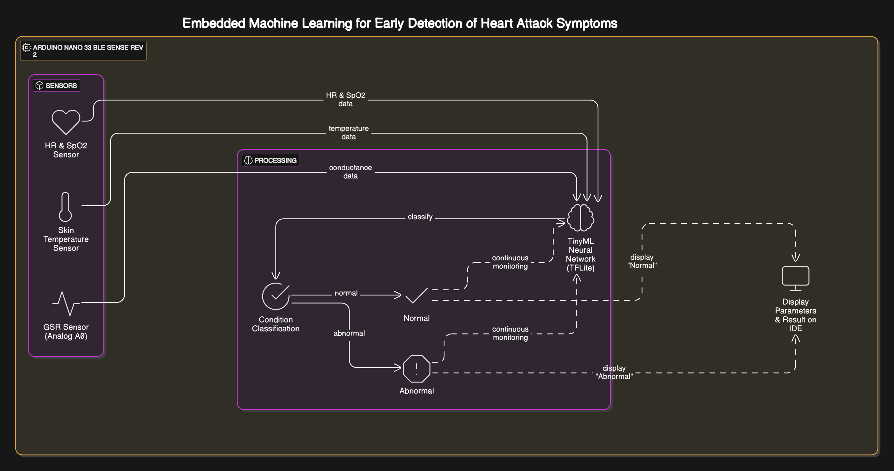
Final Architecture Diagram

Slide 14

A Real-Time Product for Practical Implementation
This project is designed as a product-based solution that can be implemented in real-time applications. By integrating Embedded Machine Learning (ML) with vehicles, this system provides continuous health monitoring for drivers and ensures road safety.
Can be integrated into Electric & Fuel-Powered Vehicles.
Prevents accidents caused by sudden cardiac issues.
Works in real-time, without cloud dependency.
Sends alerts for early intervention, saving lives.

Slide 15


Project SDG
This project aligns with United Nations Sustainable Development Goal (SDG) 3: Good Health and Well-being, which focuses on ensuring healthy lives and promoting well-being for all at all ages.
How does this project support SDG 3?
Prevention of Life-Threatening Conditions
By detecting heart attack symptoms early, the system helps prevent fatal accidents and improves driver safety.
Reducing Premature Mortality
Heart attacks cause sudden deaths, often due to unrecognized symptoms.
Early detection = Timely intervention = Lives saved.
Aligns with SDG Target 3.4
This project directly supports SDG Target 3.4, which aims to reduce mortality from non-communicable diseases (NCDs) like cardiovascular diseases through prevention and treatment.

Slide 16
Conclusion
This project is not just an academic study—it is a real-time, product-based solution that supports global health objectives. By integrating ML with SDG 3 goals, this system saves lives, reduces accidents, and improves well-being worldwide.
With advancements in sensor technology and embedded ML, this system has the potential for widespread adoption in autonomous vehicles, fleet management, and commercial transportation.
As the demand for smart health monitoring systems increases, such innovations will play a crucial role in making healthcare proactive rather than reactive. This project lays the foundation for future research into multi-sensor fusion, AI-driven diagnostics, and IoT-enabled emergency response systems, contributing to a safer and healthier future for all.

Slide 17
Thank You

